Slide 1

Entente Florale Europe – 50th anniversary Survey & Communication Insights
26th September 2025.
Eszter TÓTH

Slide 2
Introduction
In 2025, a survey was carried out among participating countries and towns.
Aim of the survey: to gather experiences and challenges from participating countries and towns and suggestions for future improvements
Communication support included social media (Facebook, Instagram) posts.

Slide 3
Methodology
Tool: Online questionnaire (Google Form).
Target group: National associations and towns that participated in EFE.
Content: 14 questions (motivation, challenges, communication, impact).

Slide 4
The Questions
The name of the settlement and country, participation year, Award achieved, special award receive
Who participated in the preparation and organization of the competition?
What locations did the jury visit on the jury day?
What were the most memorable moments of the competition participation?
Who was the driving force on the day of the jury visit? (Name, title/role)
What was the most important outcome of the competition participation?
If there were any other specific outcomes, what were they?
What do you consider to be the greatest value of the Entente Florale Europe awards scheme?
What is your message for future Entente Florale Europe participants.

Slide 5
Response Rate
Countries contacted: Austria, Belgium, Croatia, Hungary, Luxemburg, Portugal, Romania, Slovakia, Slovenia, Switz, The Nederlanden, United Kingdom
(Czech Republic, France, Germany, Italy, Ireland)
settlements contacted: 340+
Responses received: 49 (Belgium 1, Czechia 3, France 2, Germany 6, Austria 1, Hungary 20, Italy 11, Ireland 5)
Key point: broad geographical spread, but uneven participation.

Slide 6
Main Findings – Motivation
Towns joined to:
  Showcase their beauty and community spirit
  Learn from other European towns
  Strengthen tourism and international visibility
Quote: “Our participation in the competition was a positive experience and encouraged the committee to continue with its efforts and endeavours.” (Keadue, Ireland)

Slide 7
Communication & Social Media
Facebook and Instagram posts were created highlighting award-winning towns.
Posts included: landscape, cityscape, historical facts, jury visits, photos of monuments.

Slide 8
„What do you consider to be the greatest value of the Entente Florale Europe awards scheme?”
Creating a clean and well-organized environment, strengthening environmental awareness, which makes the settlement beautiful and livable for future generations as well.(Balatonföldvár, Hungary)
The competition allows for collaboration with community and other organisations and mentors and the interaction with the jury panel on adjudication day is very beneficial. (Keadue, Ireland)
European visibility and communication tools that are not accessible for small villages. (Saint Fraimbault, France)
For the promotion and enhancement of territories and raising awareness about caring for green spaces and blooming. (Limone Piemonte, Italy)
Strengthening the importance of green spaces and biodiversity in the city while connecting diverse stakeholders across the urban community. (Münster, Germany)
A huge shift in ensuring a sustainable environment and increasing the cohesion of the municipality's residents. (Dobrochov, Czech Republic)

Slide 9
„What is your message to future EFE participants?”
Proudly undertake and show the values ​​and environmental beautification traditions of their settlement, and think about complex, sustainable, environmentally conscious solutions for their entire settlement. (Kaposvár, Hungary)
Get lots of partners, set out your goals and enjoy and learn from the experience. We wish you all continued success. (Ennis, Ireland)
It's a lot of work but it's very rewarding. (Guyencourt-Saulcourt, France)
It is an important opportunity for a public administration to be able to identify the city's strengths and the weaknesses that need to be worked on in order to obtain the maximum recognition. (Comune di Grado, Italy)
Participation offers a unique opportunity to create significant added value for the future of your community or city. It promotes social cohesion and strengthens a sense of community, which in the long term provides positive impetus for local development. (Bad Langensalza, Germany)
Participating in the competition involves a lot of extra work, but more important than the results or the color of the award are the experiences gained from experts, the evaluation jury, the opportunity to talk with other participants and learn about their work, to share enthusiasm for positive change in our environment, and to build new friendships. For all these reasons and more, it is truly rewarding to be part of the competition! (Chorušice, Czech Republic)

Slide 10
Conclusions
The survey showed:
  Increase in the town's recognition and reputation
  Appearance and permanence of higher environmental quality
  Higher level of community engagement and involvement in green space development and maintenance
  Development of a more livable town

Slide 11
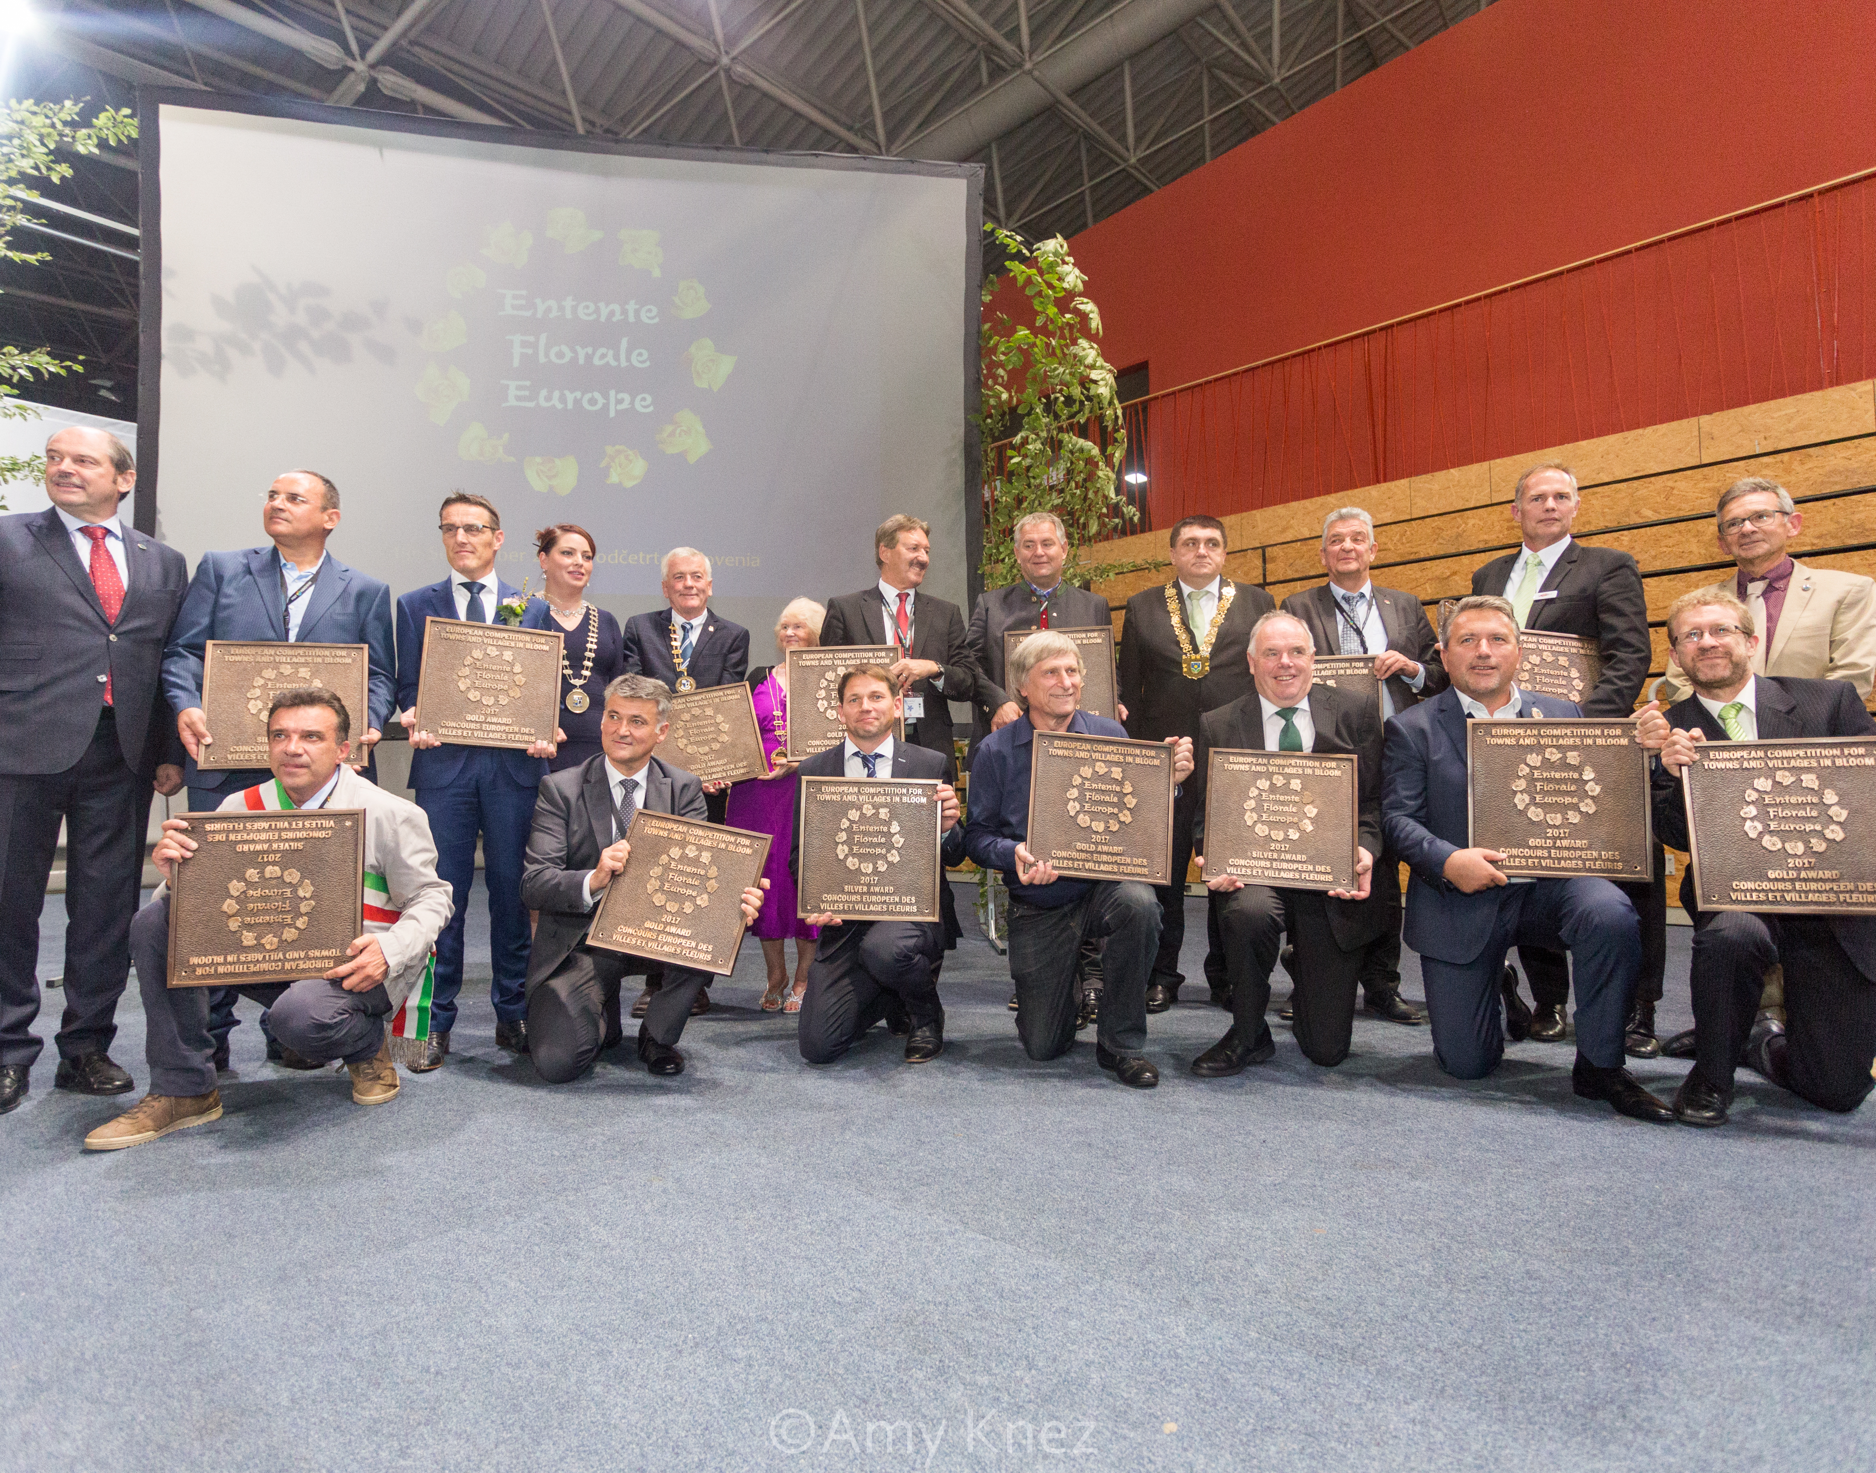
Thank you for your attention!
For more information: entente.florale50@gmail.com

